Slide 1

Databases
By: Manoja Weerasekara

Slide 2
Section 03 SQL

Slide 3
What is SQL?
SQL is an ANSI (American National Standards Institute) standard language for accessing and manipulating database systems.
SQL statements are used to retrieve and update data in a database.
SQL works with database programs like ,
Microsoft SQL server
MySQL
IBM-DB2
Informix
Microsoft Access

Slide 4
When a user wants to get some information from a database file, he can issue a query.
A query is a user request to retrieve data or information with a certain condition.
The result of the query will then be stored in form of a table.
The program will go through all the records in the database file and select those records that satisfy the condition(searching).
SQL is a query language that allows user to specify the conditions. (instead of algorithms)
There are many different versions of the SQL language.

Slide 5

SQL language is divided into three types of primary language statements.
DML (Data Manipulation Language)
DDL (Data Definition Language)
DCL (Data Control Language)

Slide 6

DDL deals with database schemas and descriptions, of how the data should reside in the database.
CREATE – to create database and its objects like (table, index, views, store procedure, function and triggers)
ALTER – alters the structure of the existing database
DROP – delete objects from the database
TRUNCATE – remove all records from a table, including all spaces allocated for the records are
removed
COMMENT – add comments to the data dictionary
RENAME – rename an object

Slide 7

DML deals with data manipulation, and includes most common SQL statements such SELECT, INSERT, UPDATE, DELETE etc, and it is used to store, modify, retrieve, delete and update data in database.
SELECT – retrieve data from the a database
INSERT – insert data into a table
UPDATE – updates existing data within a table
DELETE – Delete all records from a database table

Slide 8


DCL is short name of Data Control Language which includes commands such as GRANT, and mostly concerned with rights, permissions and other controls of the database system.
GRANT – allow users access privileges to database
REVOKE – withdraw users access privileges given by using the GRANT command

Slide 9

SQL keywords are NOT case sensitive
“select” is the same as “SELECT”.
Some database systems require a semicolon at the end of each SQL statement.
Semicolon is the standard way to separate each SQL statement in database systems. That allow more than one SQL statement to be executed in the
same call to the server.

Slide 10
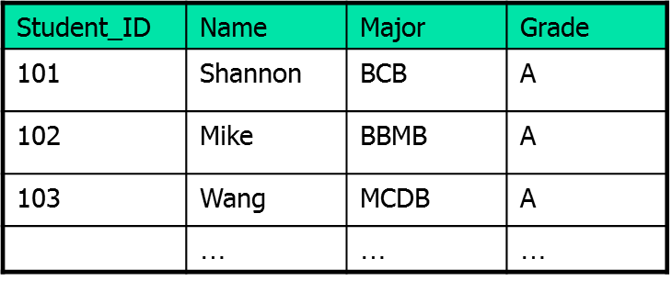
Database and Database Management System
Database is simply a collection of data. In relational database, data is organized into tables.
Database Management System (DBMS) is software to maintain and utilize the collections of data (Oracle, DB2, MySQL)

Slide 11
Basic MySQL Operations
Create database
Create table
Insert records
Load data
Retrieve records
Update records
Delete records
Modify table
Join table
Drop table
Count, Like, Order by, Group by
More advanced ones (sub-queries, stored procedures, triggers, views …)

Slide 12
Create Database
What are the current databases at the server?
mysql> show databases;
+--------------+
| Database |
+--------------+
| mysql | mysql is a database (stores users’ password …) used by system.
| test |
+--------------+
Create a database (make a directory) whose name is MyDB
mysql> create database MyDB;
Select database to use
mysql> use MyDB;
Database changed
What tables are currently stored in the MyDB database?
mysql> show tables;
Empty set (0.00 sec)

Slide 13
Create Tables
To begin with, the table creation command requires the following details
Name of the table
Name of the fields
Definitions for each field
CREATE TABLE <table_name>
(field_name1 data_type(field_size),
field_name2 data_type(field_size),
….
….
field_name data_type(field_size)
);

Slide 14
Create Tables
CREATE TABLE table_name (column_name column_type);
create table Book(
book_id INT NOT NULL AUTO_INCREMENT,
book_title VARCHAR(100) NOT NULL,
book_author VARCHAR(40) NOT NULL,
submission_date DATE,
PRIMARY KEY (book_id )
);

Slide 15
Thank You

